Slide 1

COMPUTER NETWORKS
Sivaraman Eswaran Ph.D.
Department of Computer Science and Engineering

Slide 2

COMPUTER NETWORKS
Application Layer
Sivaraman Eswaran Ph.D.
Department of Computer Science and Engineering

Slide 3
COMPUTER NETWORKS
Unit – 2 Application Layer
2.1 Principles of Network Applications
2.2 Web, HTTP and HTTPS
2.3 The Domain Name System
2.4 P2P Applications
2.5 Socket Programming with TCP & UDP
2.6 Other Application Layer Protocols

Slide 4
COMPUTER NETWORKS
DNS: Domain Name System
people: many identifiers:
SSN, name, passport #
Internet hosts, routers:
IP address (32 bit) - used for addressing datagrams
“name”, e.g., cs.umass.edu - used by humans
Q: how to map between IP address and name, and vice versa ?
Domain Name System:
distributed database implemented in hierarchy of many name servers
application-layer protocol: hosts, name servers communicate to resolve names (address/name translation)
note: core Internet function, implemented as application-layer protocol
complexity at network’s “edge”

Slide 5
COMPUTER NETWORKS
www.abc.example.com -> Canonical Host Name
www.example.com -> Alias Name
DNS: Services, Structure
DNS services
hostname to IP address translation
host aliasing
canonical, alias names
mail server aliasing
load distribution
replicated Web servers: many IP addresses correspond to one name
Q: Why not centralize DNS?
single point of failure
traffic volume
distant centralized database
maintenance
www.abc.example.com -> Canonical Host Name
bob@example.com -> Alias Name
A: doesn‘t scale!
Comcast DNS servers alone: 600B DNS queries per day

Slide 6
COMPUTER NETWORKS
DNS: a distributed, hierarchical database
Root DNS Servers
Root
…
…
.com DNS servers
.org DNS servers
.edu DNS servers
Top Level Domain
…
…
…
…
yahoo.com
DNS servers
amazon.com
DNS servers
pbs.org
DNS servers
nyu.edu
DNS servers
umass.edu
DNS servers
Authoritative
Client wants IP address for www.amazon.com; 1st approximation:
client queries root server to find .com DNS server
client queries .com DNS server to get amazon.com DNS server
client queries amazon.com DNS server to get IP address for www.amazon.com

Slide 7
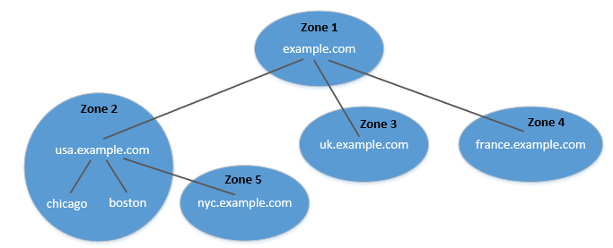
COMPUTER NETWORKS
DNS Zone vs Domain
DNS is organized according to zones.
A zone groups contiguous domains and subdomains on the domain tree.
Assign management authority to an entity.
The tree structure depicts subdomains within example.com domain.
Multiple DNS zones one for each country. The zone keeps records of who the authority is for each of its subdomains.
The zone for example.com contains only the DNS records for the hostnames that do not belong to any subdomain like mail.example.com

Slide 8
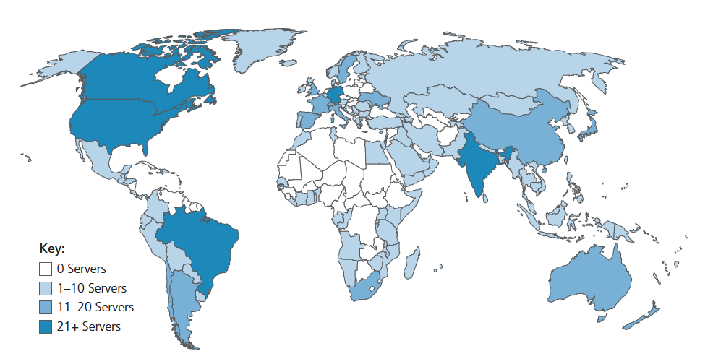
COMPUTER NETWORKS
DNS: root name servers
official, contact-of-last-resort by name servers that can not resolve name
incredibly important Internet function
Internet couldn’t function without it!
DNSSEC – provides security (authentication and message integrity)
ICANN (Internet Corporation for Assigned Names and Numbers) manages root DNS domain
13 logical root name “servers” worldwide each “server” replicated many times (~200 servers in US)

Slide 9
COMPUTER NETWORKS
TLD: authoritative servers
Top-Level Domain (TLD) servers:
responsible for .com, .org, .net, .edu, .aero, .jobs, .museums, and all top-level country domains, e.g.: .cn, .uk, .fr, .ca, .jp
Network Solutions: authoritative registry for .com, .net TLD
Educause: .edu TLD
Authoritative DNS servers:
organization’s own DNS server(s), providing authoritative hostname to IP mappings for organization’s named hosts
can be maintained by organization or service provider

Slide 10
COMPUTER NETWORKS
Local DNS Name Servers
does not strictly belong to hierarchy
each ISP (residential ISP, company, university) has one
also called “default name server”
when host makes DNS query, query is sent to its local DNS server
has local cache of recent name-to-address translation pairs (but may be out of date!)
acts as proxy, forwards query into hierarchy

Slide 11
THANK YOU
Sivaraman Eswaran Ph.D.
Department of Computer Science and Engineering
sivaramane@pes.edu
+91 80 6666 3333 Extn 834

